Slide 1

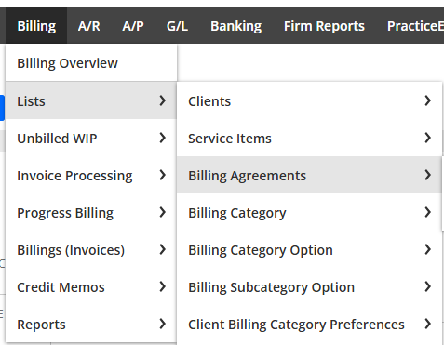
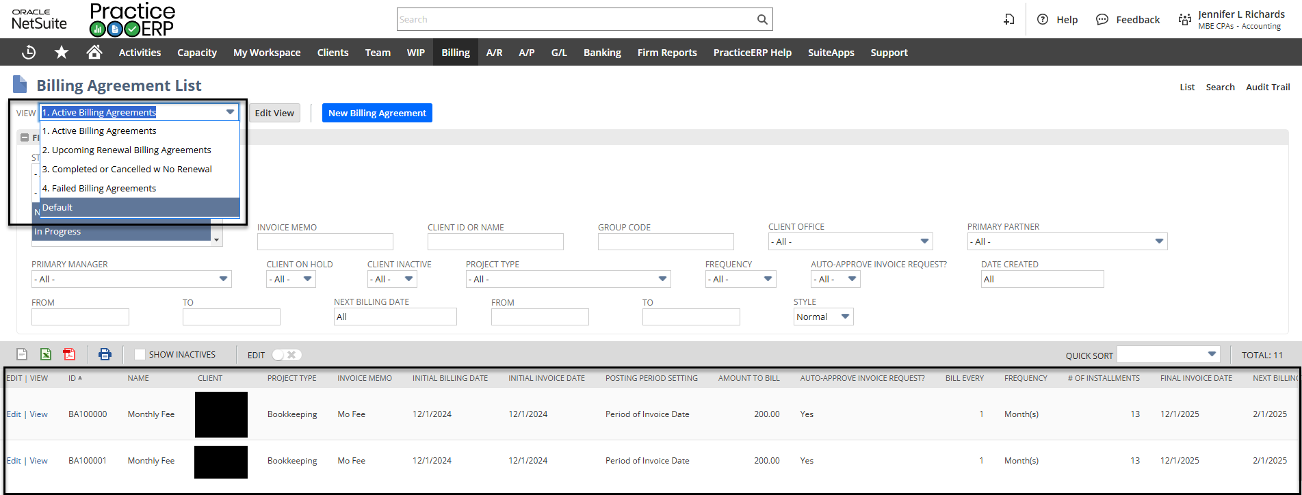
Billing Agreements
Billing Agreements are recurring Progress Billing for your clients. Billing Agreements can be found and created with the following path shown to the right.
This list shows 4 views.
  Active Billing Agreements
  Upcoming Renewal Billing Agreements
  Completed or Cancelled w No Renewal
  Failed Billing Agreements

Slide 2
Billing Agreements Continued
The Billing agreement list is a quick and effective way to find all clients who have or have had billing agreements.
There is also a New Billing Agreement button found at the top where you can enter in new agreements.

Slide 3
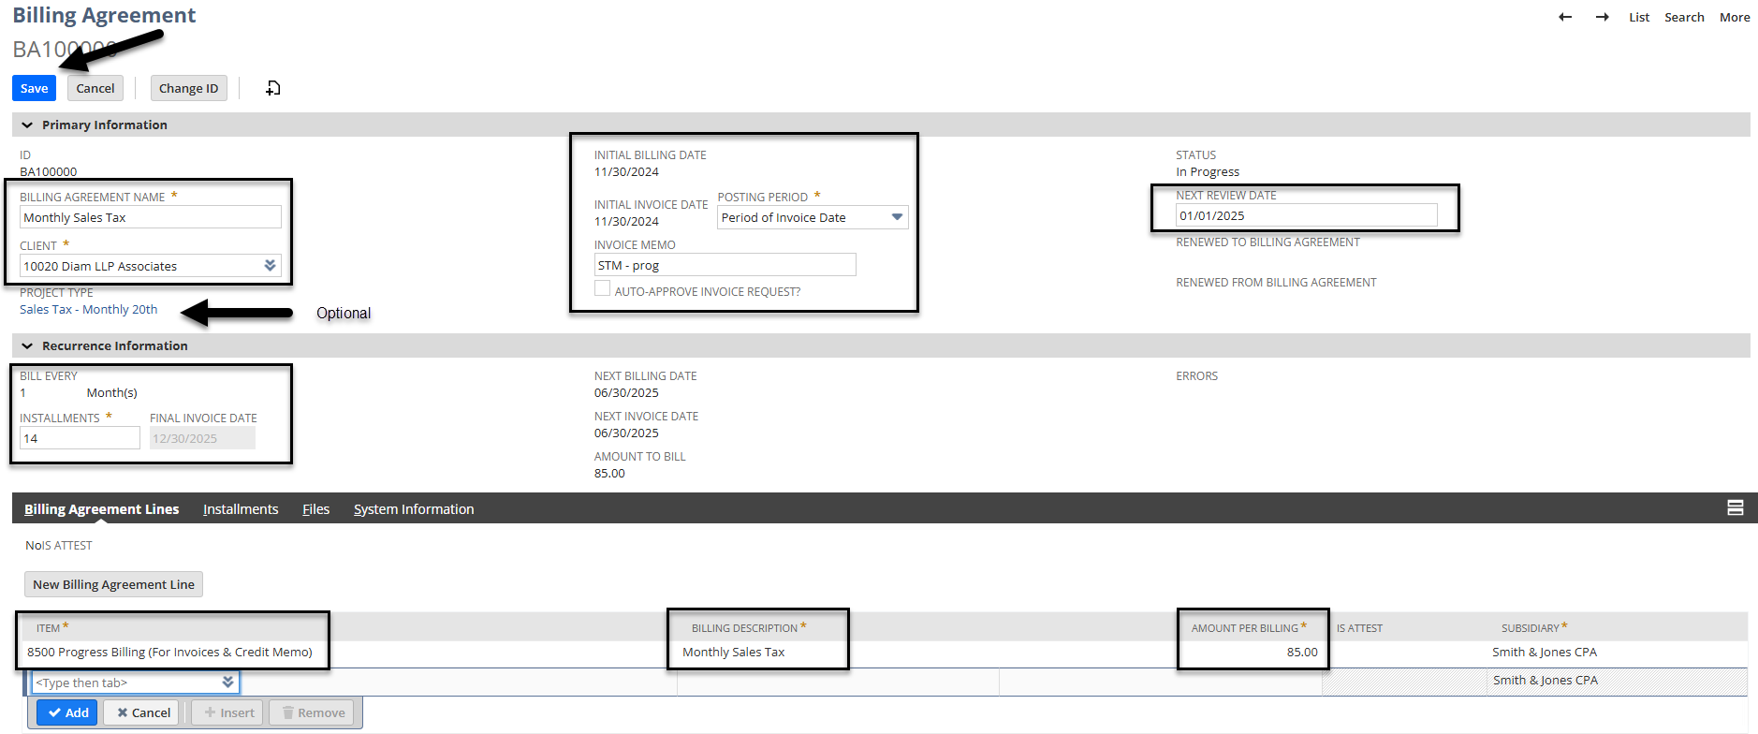
Billing Agreements Continued
When creating a new billing agreement you must fill out all fields as shown below.
In this example the name of the agreement is Monthly Bookkeeping (Clients can have multiple billing agreements or multiple lines on one billing agreement)
Enter in the client, the initial billing date and the initial invoice date
Enter in a memo to appear on the client dashboard, choose if this can be auto approved and the next review date.
  Select the Auto-Approve invoice request if you want the system to automatically generate and approve the invoice. If you do not select this box then the invoice will go into your pending approval request queue.
Continued on the next slide

Slide 4
Billing Agreements Continued
Recurrence Information
  Enter how many times you want it to bill per week, month, quarter, or year.
  Enter how many installments you would like billed. In this example I said I wanted a review date at the end of the year and then I listed eleven installments to populate until the end of the year as I will create a new one with an updated amount.
  Then create your line(s) for billing with a proper PROGRESS item, a billing description that will appear on the invoice, and the amount for the line.
  Verify everything is correct and select Save.

Slide 5
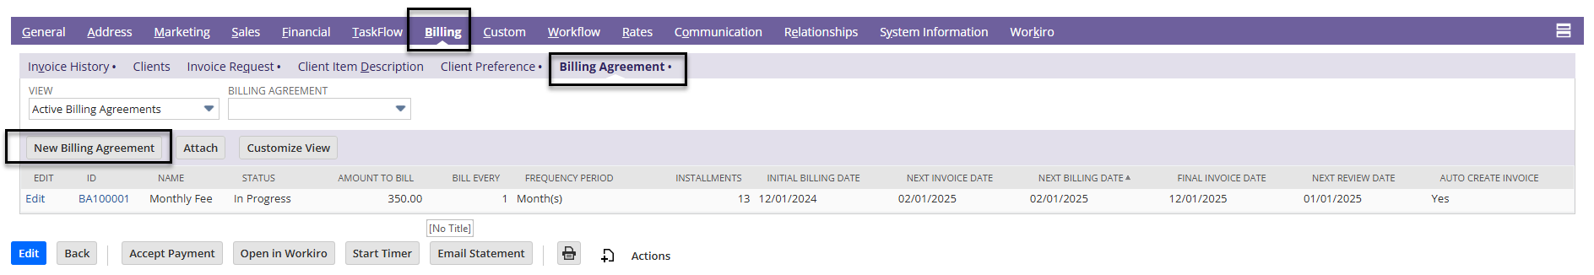
Billing Agreements Continued
Billing agreements can also be entered from a client dashboard. On the client dashboard select switch to form view in the upper right corner.
Then scroll down and select the Billing tab, Billing Agreement Tab, and New Billing Agreement
Steps to fill out the Billing agreement would be the same as listed in the previous slide.

Slide 6
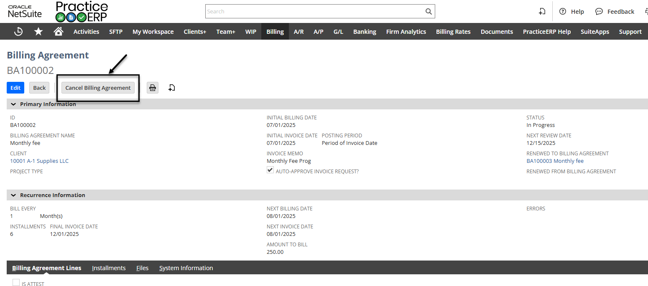
Billing Agreements Continued
If you need to cancel a billing agreement you can do so with the following steps:
  Go to Billing > Lists > Billing Agreements
  Find the billing agreement that you would like to cancel and select View in front of it.
  Once in the view screen you can select the Cancel Billing Agreement button at the top of the screen. The agreement will no longer create an invoice.

Slide 7
Billing Agreements Continued
If you would like to see the invoices that were auto-approved or are in the pending approval queue, please use the following steps:
  Go to Billing > Invoice Processing > Invoice Request (List View)
  At the top there are different views to select
    View 1a – Pending from Billing Agreements
      This lists all invoices that have a billing agreement but did not have the auto-approve box checked within the agreement
        Someone will need to review these invoices and select approve and generate in order for them to go out.
    View 5a – Completed Invoice Requests from Billing Agreements
      This lists all of the invoices that were automatically approved and generated by the system.

