Slide 1
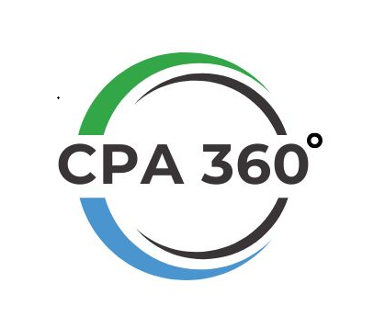
Billing 3.0
Creating Invoices
Quick Guide

Slide 2
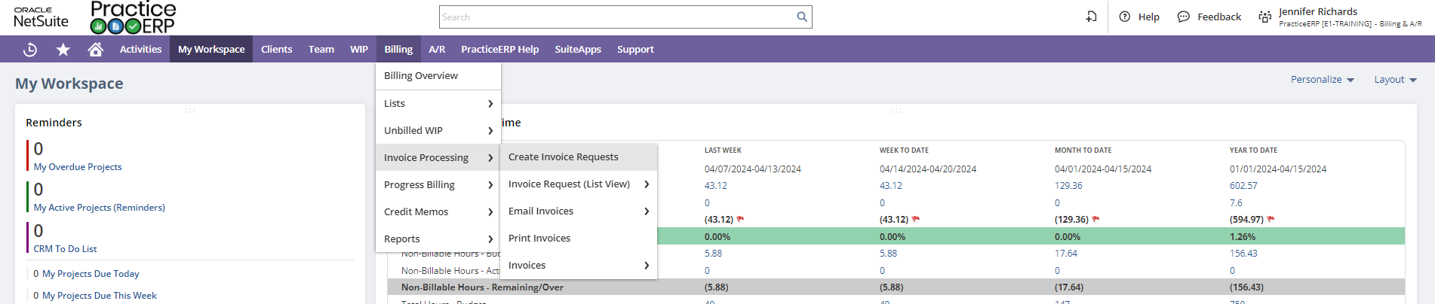
Step 1
Be in the Billing and A/R Role, Billing Role, or Accounting Role.
Go to Billing > Invoice Processing > Create Invoice Requests

Slide 3
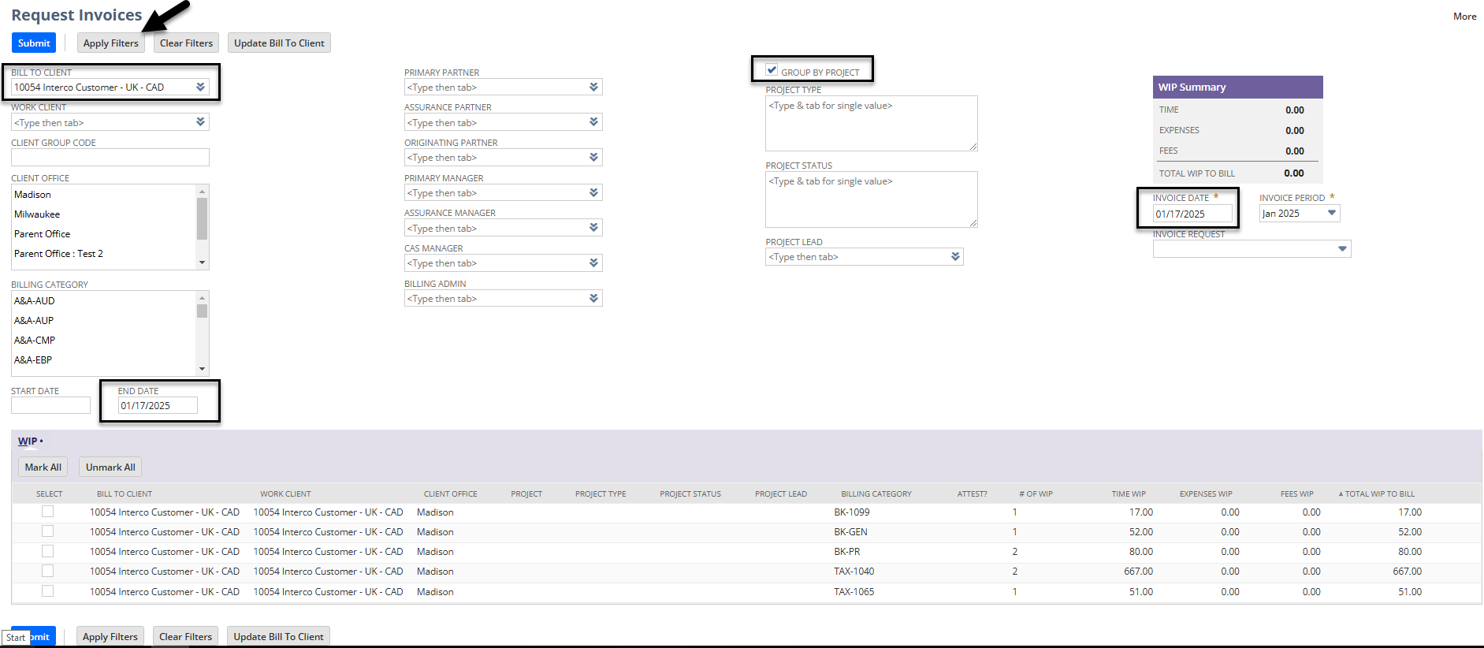
Step 2
This is the request invoice screen.
Here you want to search by Bill to client name/number. You can use the filter options of partner, manager, biller, etc if you wish. (This information would have to be represented on the client record to work.)
The end date is the date for which you want to pull the open WIP through.
The invoice date is the date that the invoice will be created for and when the amount will hit the financials. (Can do this selection on the next screen as well)
There is an option on this screen to select whether or not you would like the WIP to group by project.
Once all filters have been entered, select apply filters and the WIP will be listed by client and billing category at the bottom of the screen.

Slide 4
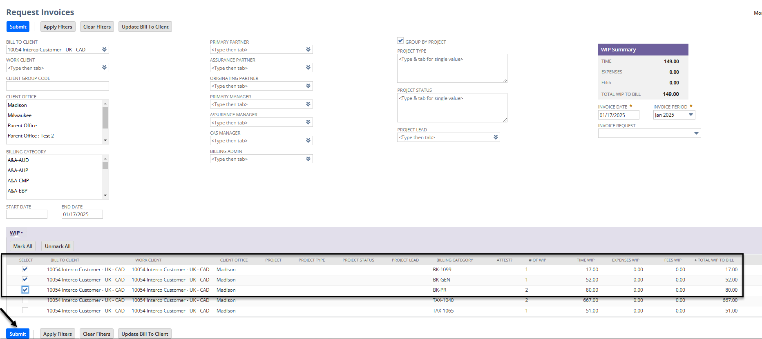
Step 3
Select the lines you would like to bill or select all and hit submit.

Slide 5
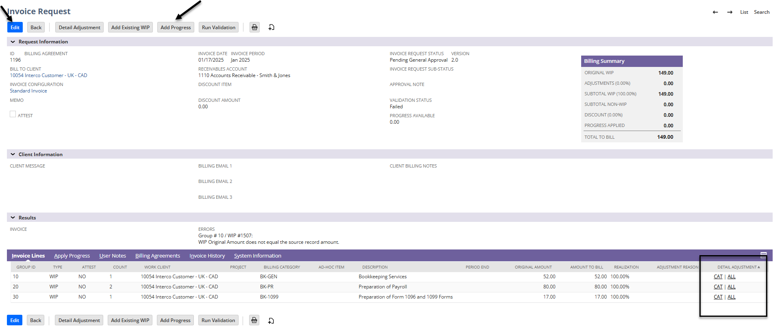
Step 4
On the Invoice Request screen you can look at the detailed entries for each line of WIP to the far right. CAT will show just the category you select and ALL will show all lines. (In this area you can also decide to hold WIP from a category as needed – shown on the next slide)
You can add progress to the existing invoice with the button at the top.
To make all edits and enter a Memo – please select Edit (Steps for the edit screen are continued on slide 7)

Slide 6
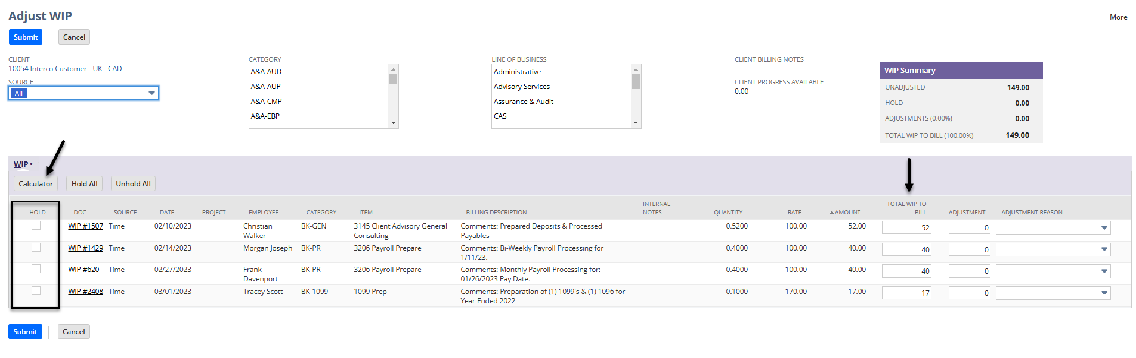
Step 4 continued
Once you select CAT or ALL you will be taken to an Adjust WIP screen as shown below
On the left you can select any WIP you would like to hold. This WIP will go back into an unbilled status and be removed from this invoice request.
This screen is also a place where you can change the amounts by line by using the Total WIP to bill column.
The calculator function will allow you to prorate a specific amount across all lines if you wish as well.

Slide 7
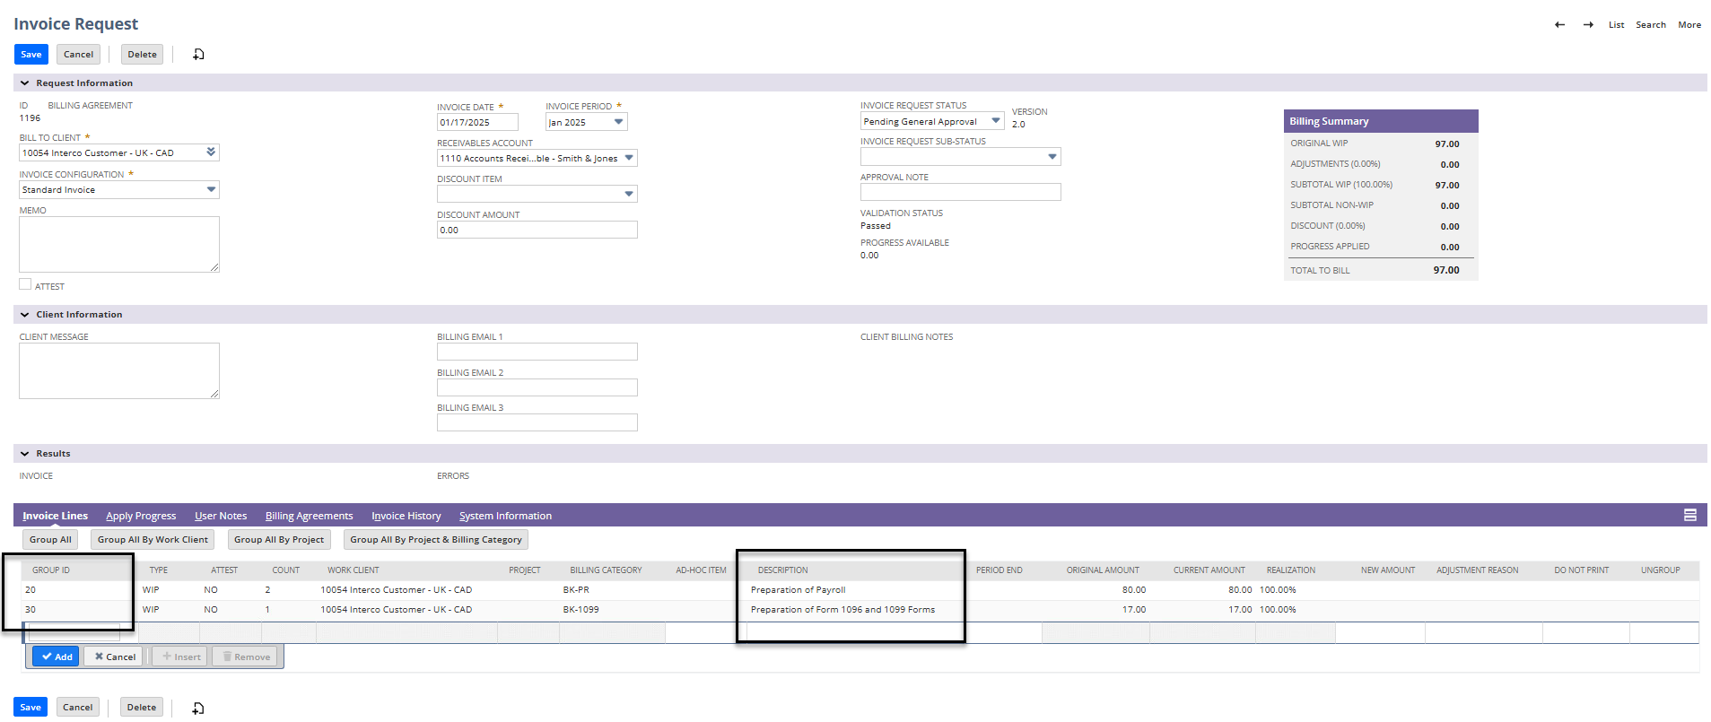
Step 5
Options within The Edit function
Group ID – how you merge lines of WIP together if you wish to only show one line or if you plan on writing some of the lines off. To do so, make the number in the group ID match which one you want to merge it with. (Bottom left box on image below)
Group ID can also be used to change the order the WIP appears on the invoice. Change the numbers to be in the numerical order you would like them to show on the invoice.
You can select the description and adjust it to be what you want the line to say on the invoice to the client. (Note: If you merge lines together be sure to erase the wording of the item you do not want to show on the invoice)
You can also see if this client has any active billing agreements and their invoice history from this screen.
Continued on the next slide

Slide 8
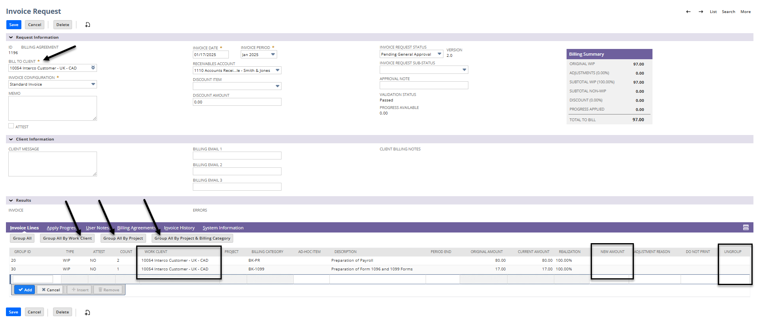
Step 5 continued
The Bill to client is what was used to pull the WIP but if WIP has been moved between clients you will see where it came from within the work client column.
New Amount – enter in the amount you want to write up or write down. (Leave as is if no change is necessary)
Ungroup – If you select this box on the specific line of business it will show the lines of WIP that went into the category. This will show the client what the staff member entered into their time description, so please check the spelling and ensure it is all client facing.
  Once this is selected ungroup you can not “re-group” the WIP and bring back the original description; you would have to select delete and then select edit again. Grouping by work client or project will merge the lines but the time entry verbiage would stay.
Continued on the next slide

Slide 9
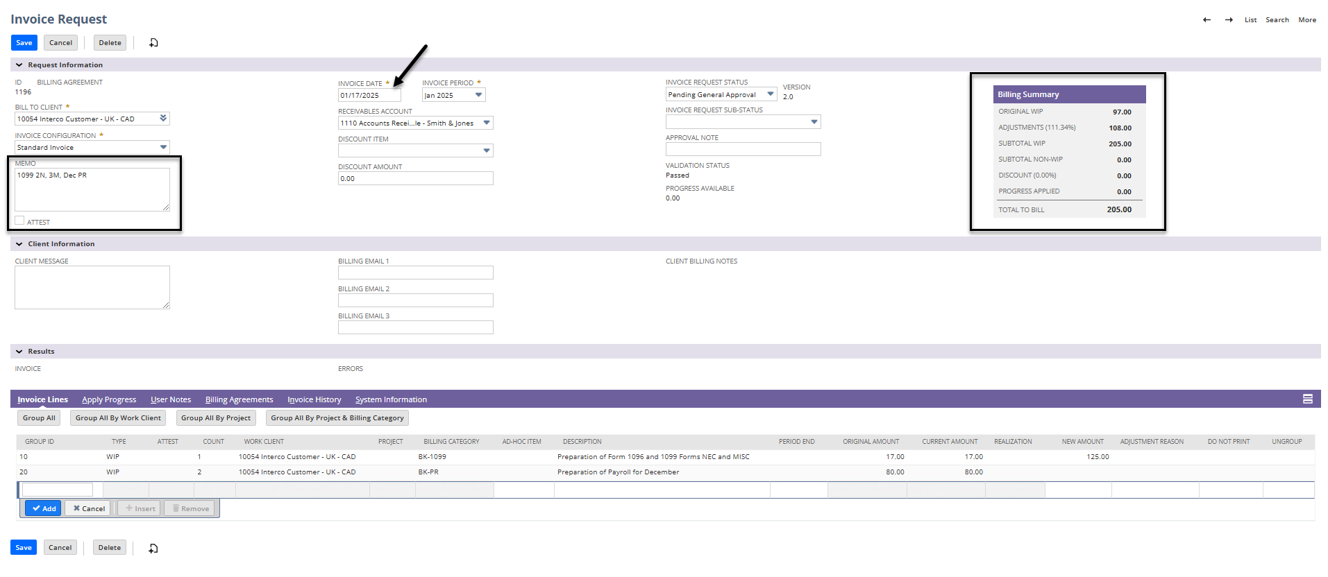
Step 5 continued
Ensure that your invoice date represents the date of which you want the amount to tie to the financials. In the example below would have this amount showing on the January financials.
After you have edited the lines you ALWAYS want to include a Memo of what the invoice is for. An example of a good memo is something like Mar BK, Mar ST, and 2022 1065 ($1200). This way you do not need to open each invoice in the future to see what was included and it is easier to find information. Also helpful with knowing the tax return amounts when looking next year and making billing decisions based on previous year. (Memos will show on the client dashboard for each invoice)
There is a billing Summary box on the right that will show you WIP amounts and adjustments.

Slide 10
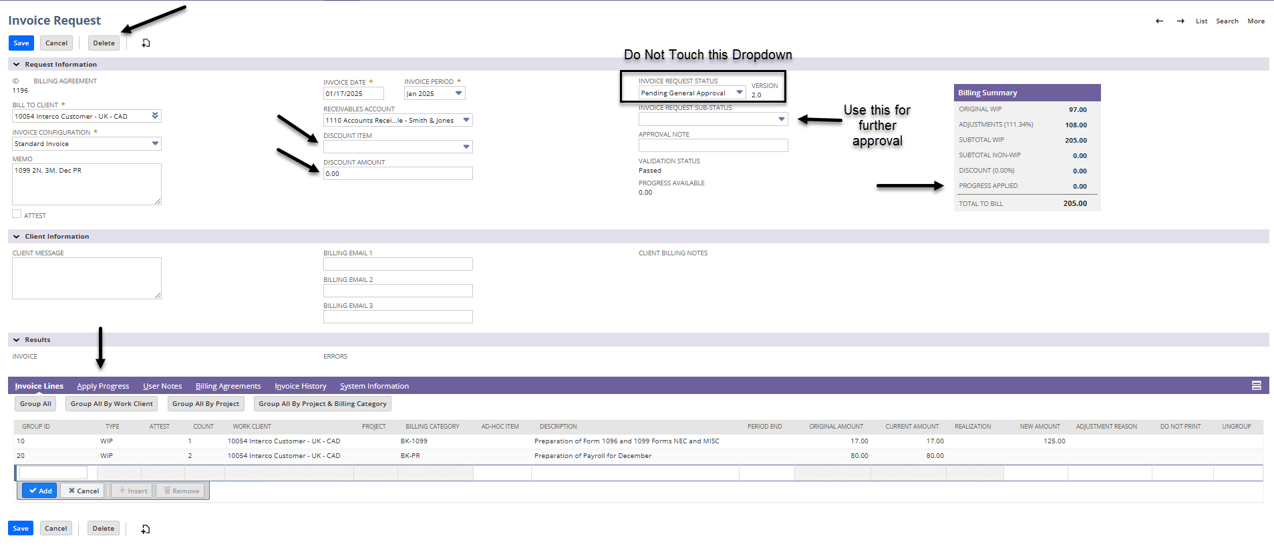
Step 5 continued
There are discount item and discount amount boxes where you can select a discount to be applied. Your firm can decide which discounts they would like available. (When you enter an amount always make sure it is negative to remove that amount from the invoice)
The Invoice Request Status selection should not be touched. This will update to the proper steps as you move through the invoice.
The Invoice Request Sub-Status dropdown is where you can mark an invoice for additional approval such as Pending Manager Approval.
If there is progress to apply it will have a yellow banner at the top stating there is progress to apply. Select the Apply Progress tab at the bottom, select the progress you want to apply to this invoice. This will remove the progress amount from the total and show the client what they have left to pay for this invoice in the Billing Summary.
If you have completed all editing and entered the correct invoice date and memo you can select Save.
Note - This is also where you can Delete an invoice request. (More on this topic at the end of the document)

Slide 11
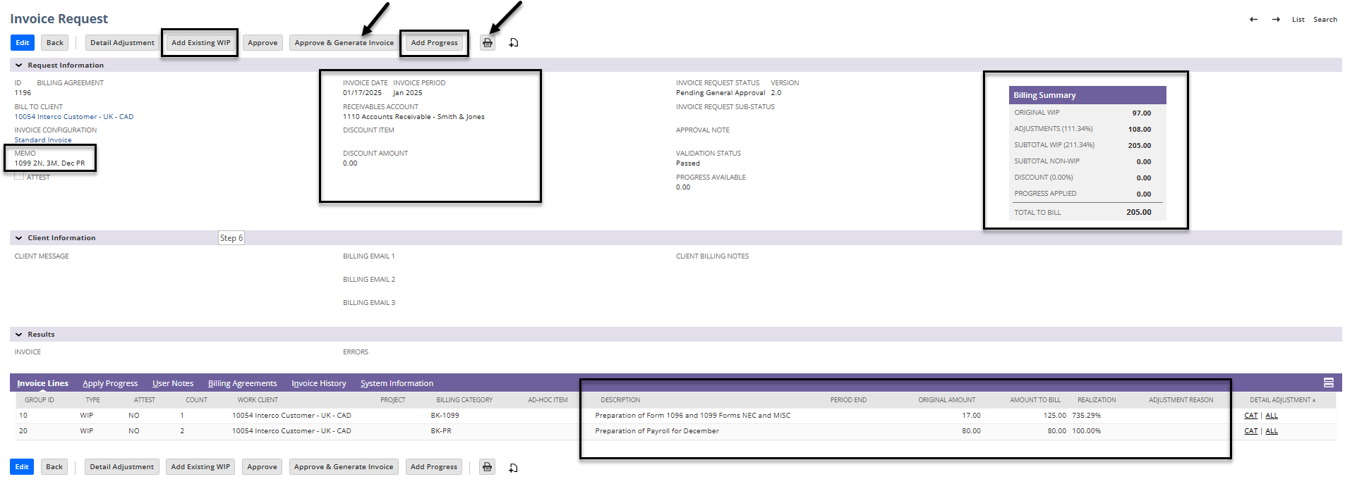
Step 6
Once you have selected Save, it will take you back to the Invoice Request screen for one final look.
In this screen you can also add additional existing WIP or add a line of progress via the buttons along the top.
If you like the layout, memo, invoice date, and dollar amount you can either print preview with the printer icon or approve and generate to finalize the invoice and generate an invoice number.

Slide 12
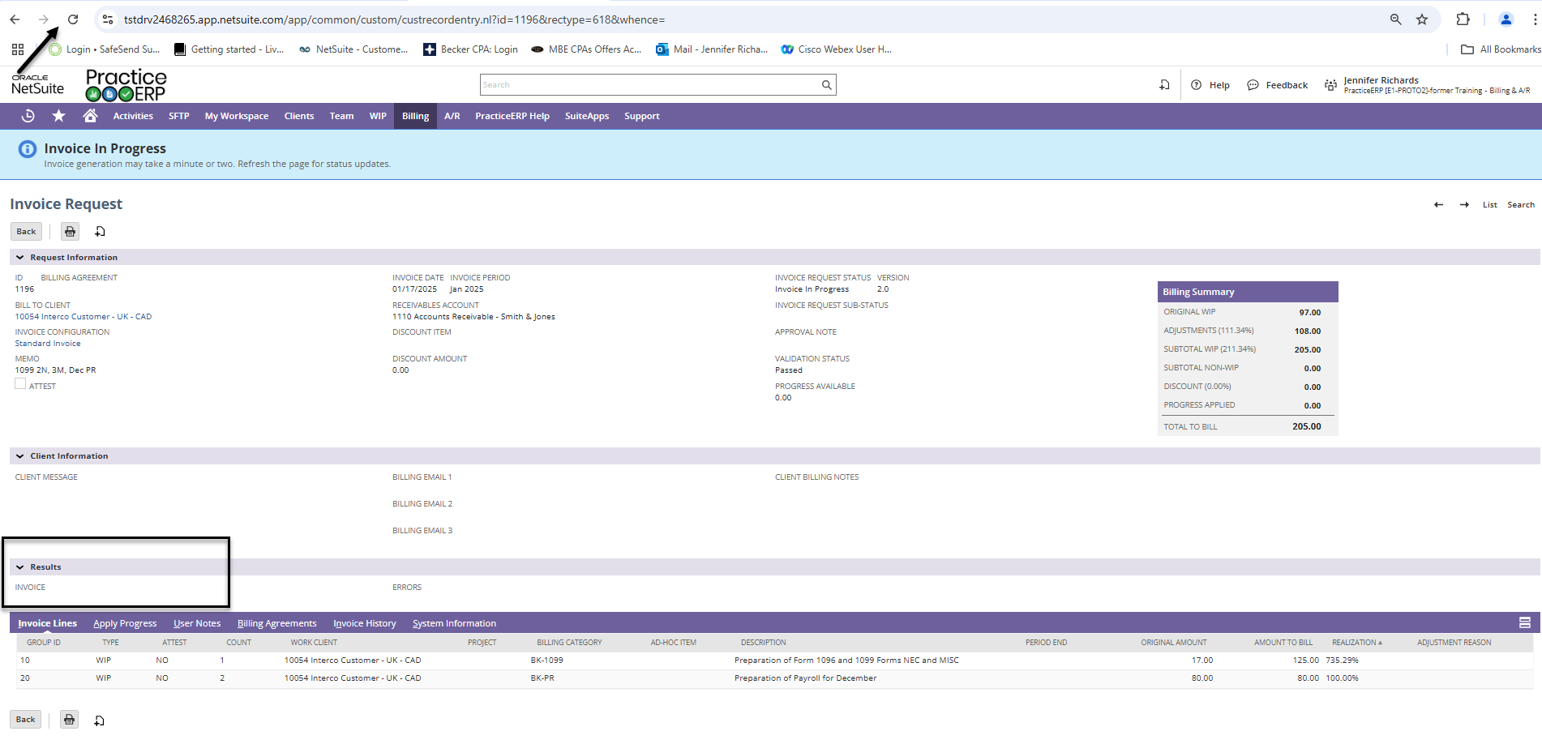
Step 6
After Approving and Generating, it will take a minute to process. You do not have to wait for it to finish processing and can go back to the billing tab to start the process for the next invoice.
If you would like to look at the invoice you can hit refresh until it processes and select the invoice number that populates as shown on the next slide.

Slide 13
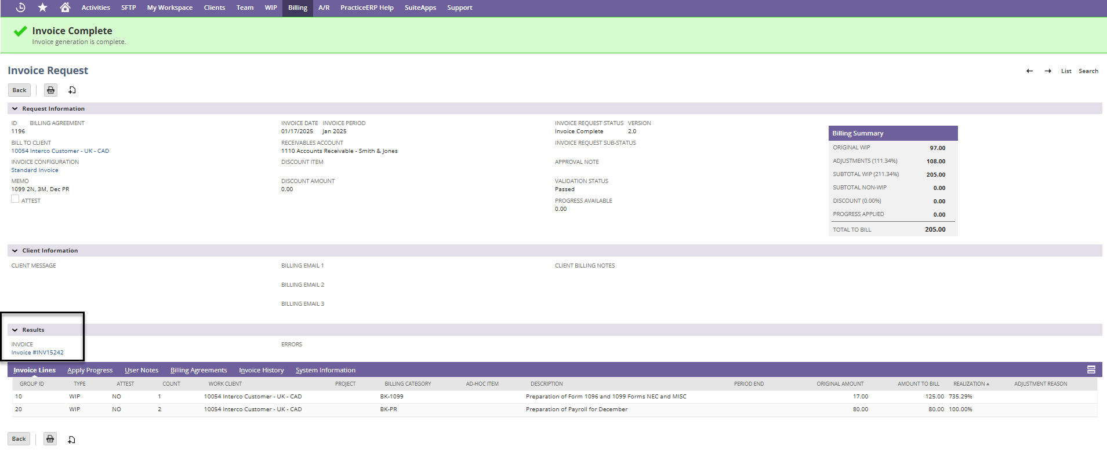
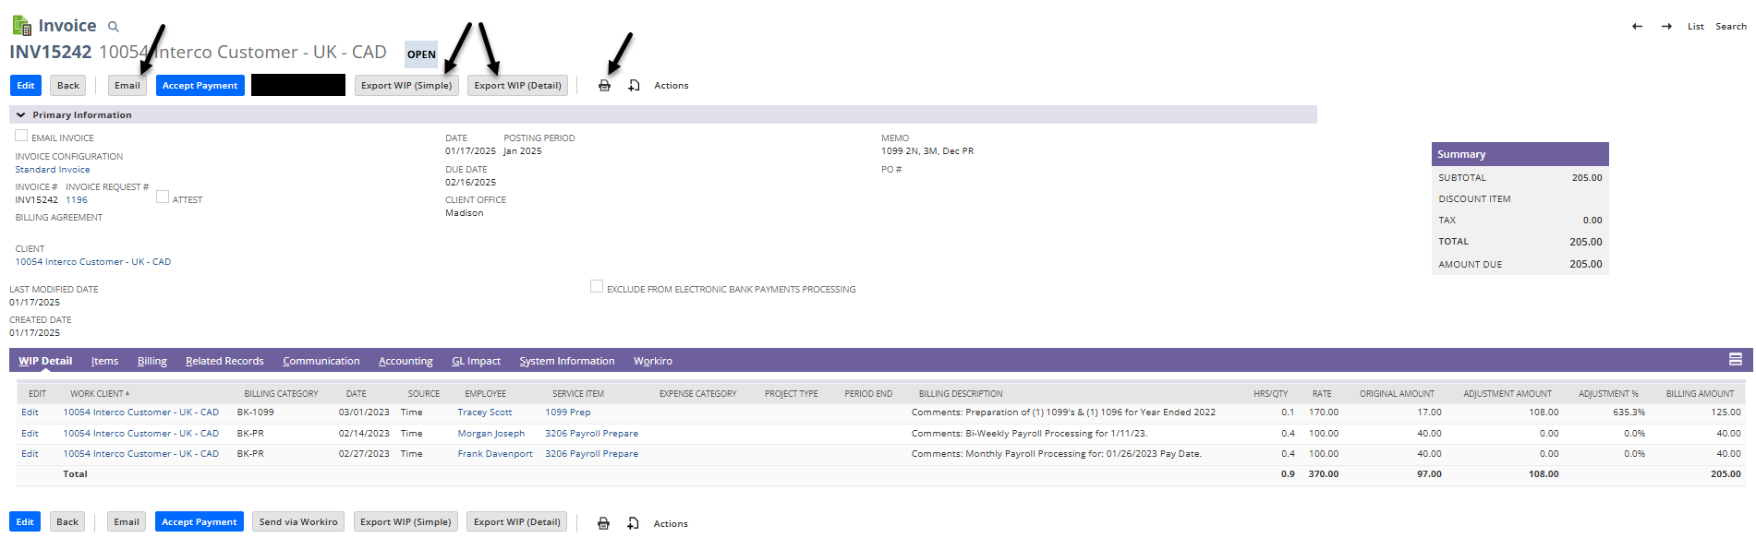
Step 6 continued
Once complete you can see the invoice number as shown below
Once the invoice is selected you can select on the printer icon to see the invoice and print if wanted.
Or you can select email to send to a client or another member of your firm to review the invoice.
You can also pull a WIP detail report from this screen to show clients the time that went into the invoice. Be aware that this will show the time entry from your staff members.

Slide 14
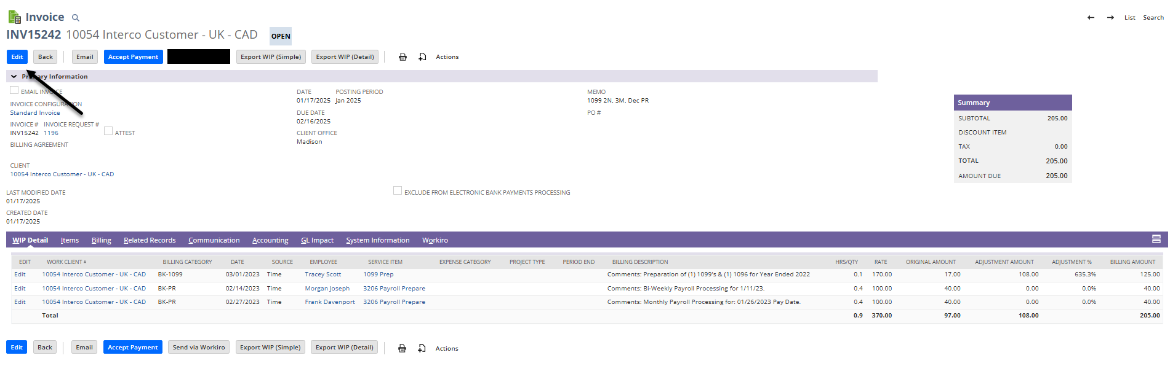
ADDITIONAL Billing Items
Deleting an Invoice
If you need to make changes to an invoice you can delete the invoice and edit it.
    You can only delete an invoice that is in an open period, otherwise it will give an error message.
    When you delete an invoice, you will delete the invoice number and physical copy, but the WIP will only revert one step and will be in Invoice Request again.
First step would be to select the invoice number (Can be from a list or from their client dashboard) and then select Edit

Slide 15
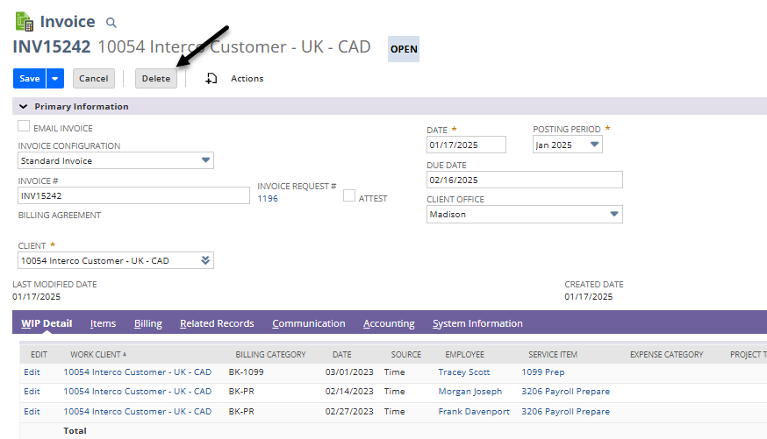
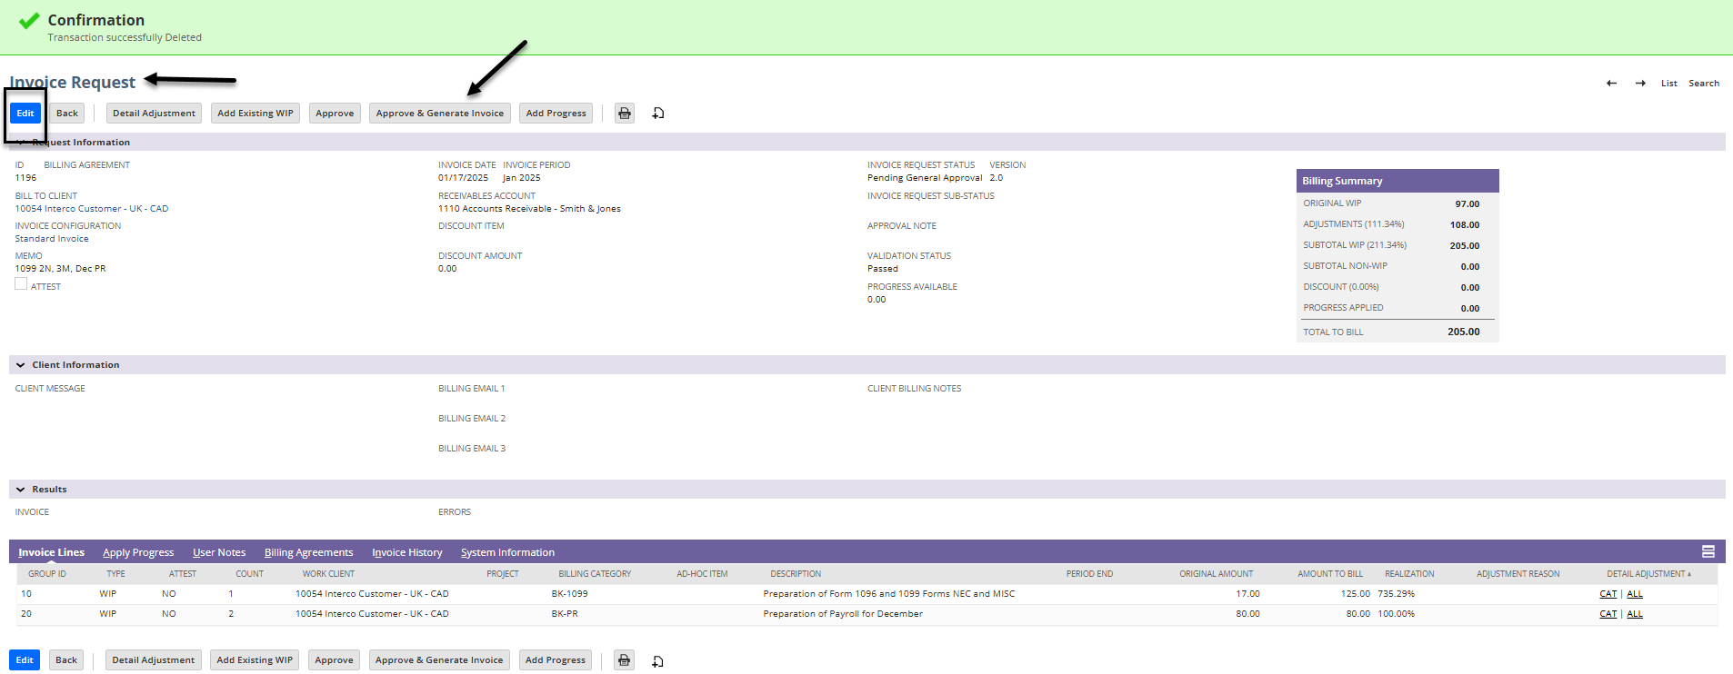
Deleting an Invoice continued
Once you are in Edit, you can select Delete at the top. It will ask you if you are sure you want to delete this transaction, select yes.
Now you will see that it is back in the Invoice request. You can select edit to make your changes, save, approve and generate.
If you want to remove it completely and put the WIP back into an unbilled status select edit and delete again and this will delete the request and move the WIP back to an unbilled status.

Slide 16
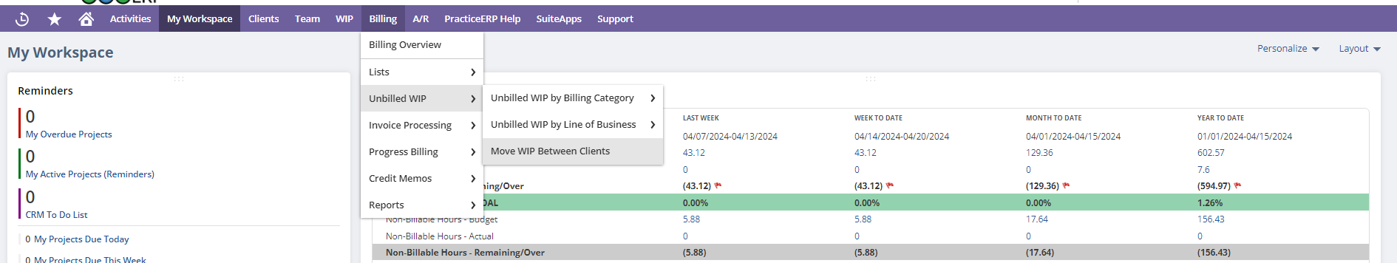
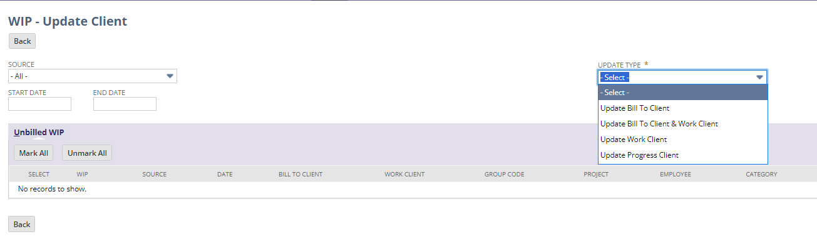
Move Client WIP
Go to Billing > Unbilled WIP > Move WIP Between Clients
On the next screen you will need to select how you would like to move the WIP

Slide 17
Move Client WIP continued
Update Bill to Client – Move the WIP so it will be billed to a different client. The record will still show who the work was originally done for.
  An example would be: having to move a personal return to a business. This would allow you to see how much WIP was from the personal and how much for the business.
Update Bill to Client and Work to Client – Move the WIP so it will be billed to and associated with a different client. After this change, it will look as though the work was always for that new client.
  An example would be: if a staff member put time to a wrong client and it needs to be moved to the correct one, you would use this selection
Update Work Client – Change who the work is shown as being done for without affecting who will be billed. Use this mainly to correct mistakes.
  An example would be: If you accidentally move the WIP using the “Update Bill to Client and Work Client” and meant to just move the Bill To Client. Basically, it would be a corrective action to update the Work Client.
Update Progress Client – Move the Progress WIP so it will be available to the new client. Note: This can only be used on Progress that has not yet been applied.
  An example would be: if progress was billed under a personal account and the personal was going to be billed out of the business. (WIP would be moved) The progress would then need to be moved to the business to apply it when the invoice is created.

Slide 18
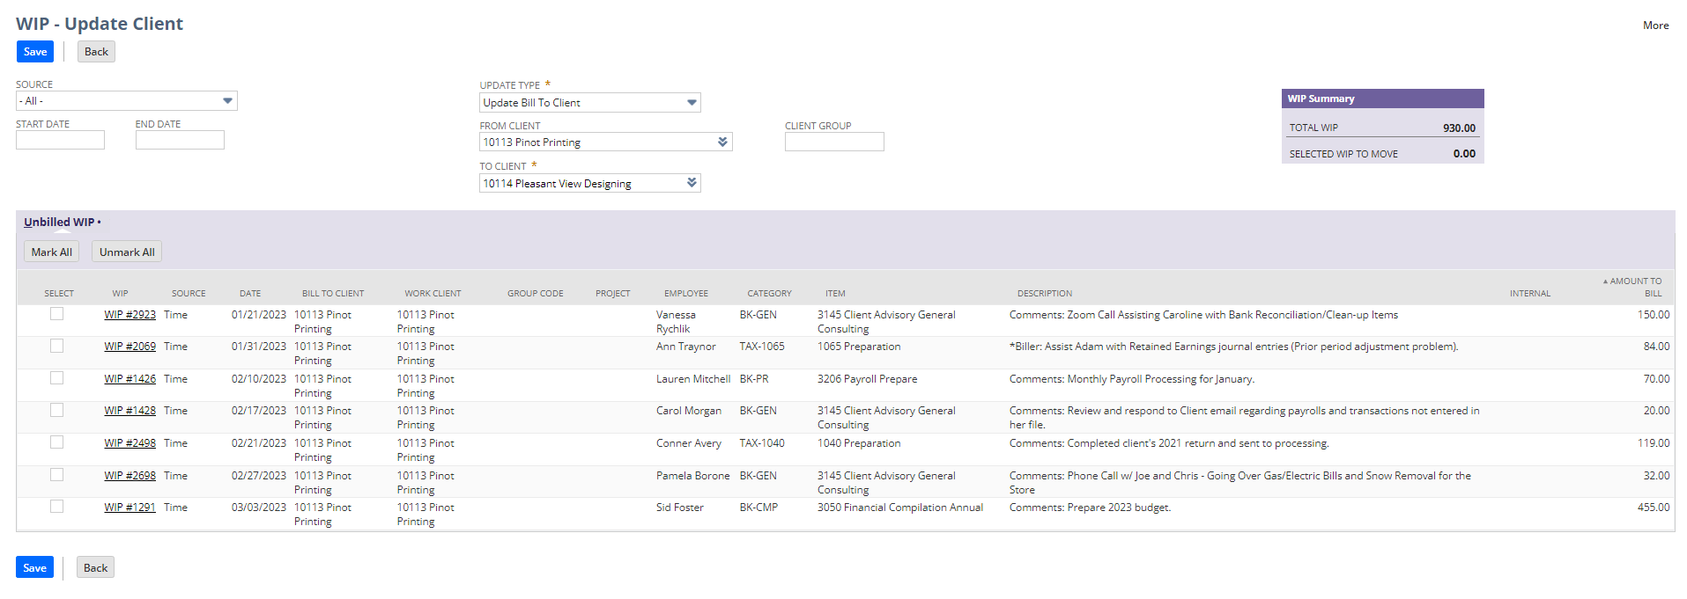
Move Client WIP continued
Most commonly used update types will be: Update Bill to Client (for billing elsewhere) and if their time was entered to the wrong client then Update Bill to Client and Work Client
Once you have selected your update type you will need to enter in the client the WIP is coming from, wait for the WIP to populate.
Then enter the client it will be moving to.
You can then select the WIP you wish to move. This will total in the WIP summary to the right.
Select Save

Slide 19
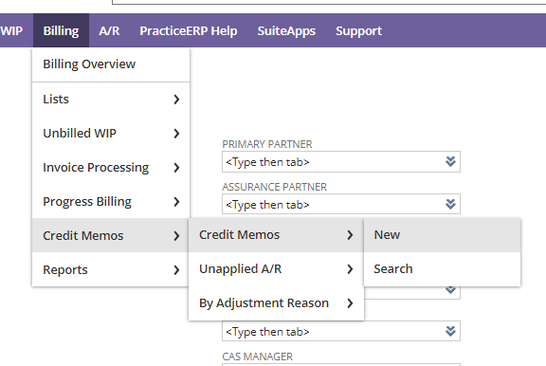
Credit Memo
A credit memo is to be used when an invoice amount needs to be changed and a period is closed.
    Only firm authorized personnel should create credit memos.
If a credit memo is created to adjust an invoice amount, it should be applied to the correct invoice at the time of creation.
Credit memos can also be used as a way to place a credit on a clients account. This is done by creating the memo and not applying to an invoice.
To create a credit memo go to Billing > Credit Memos > Credit Memos > New

Slide 20
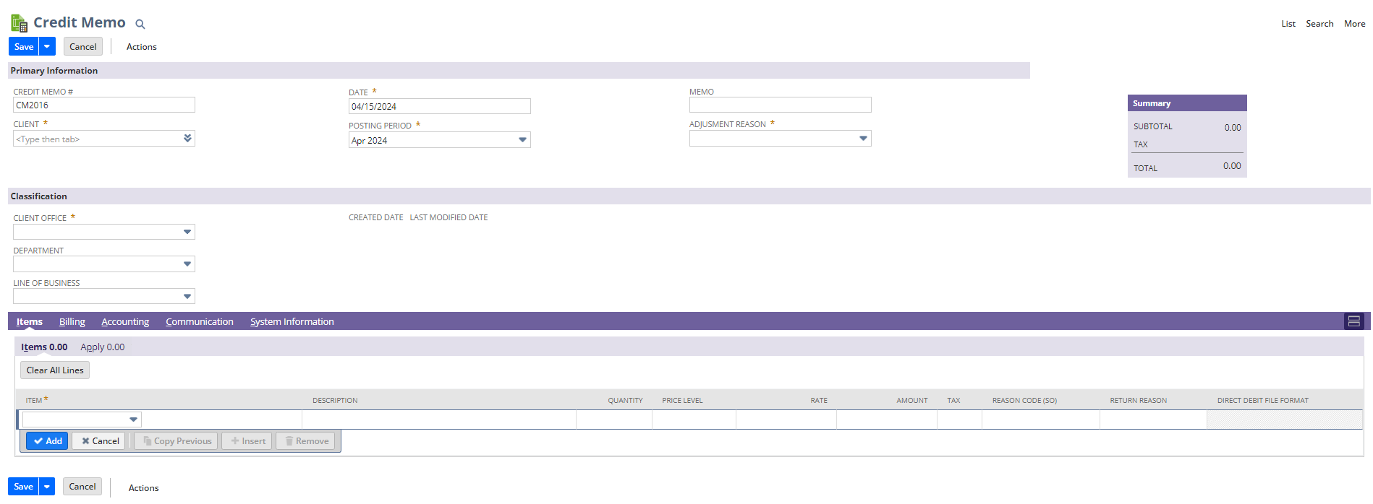
Credit Memo Continued
Once you are in the credit memo screen you will need to select/enter:
  Client, memo (why are you doing a credit), adjustment reason, and client office
  Then in the bottom portion you will need to select an item, enter a description, and the amount. (This is continued on the next slide)

Slide 21
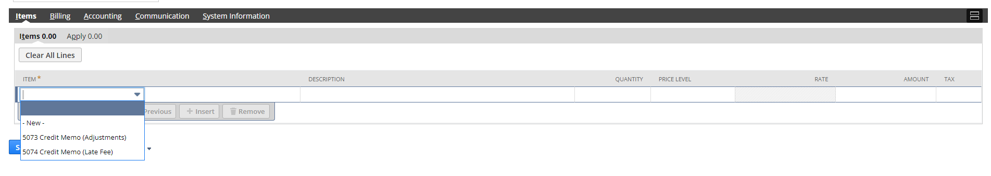
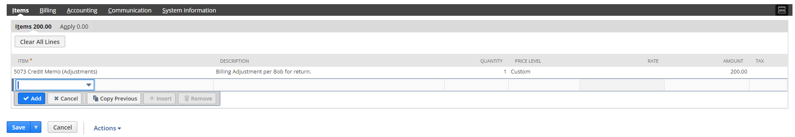
Credit Memo Continued
You should have 2 accounts to pick from in the item column if your firm processes late fees. One will be for adjustments against invoices or to credit an account. The other will be to credit back late fees that you have entered to a client account. (If you only have the adjustment item then you will need to create the late fee item number and have it route to the proper income account for your late fees)
Once you have the information as shown in the boxes below select add.
This will give the credit memo an amount in the item tab.
  If you want to put this to the client record as a credit, select Save.
  If this needs to be applied to an invoice select the apply tab.

Slide 22
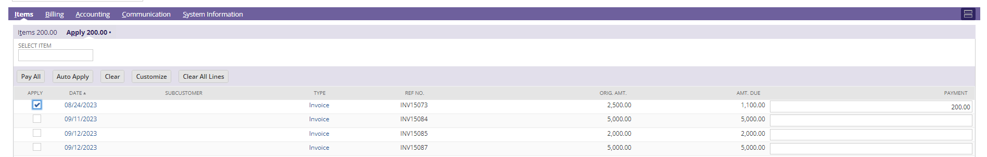
Credit Memo Continued
Once you select the Apply tab there will be a list of open invoices for the client and you can select the box in front of the invoice you wish to apply it to. This amount will then show on the Apply tab as well.
  Please see the image below for these steps.
The item and apply tabs should show the same amount. If they do, then you can hit save.

Slide 23
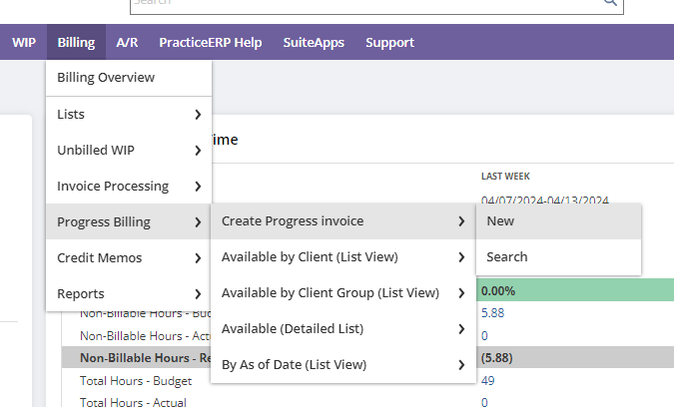
Progress Billing
Progress billing is to ask for a payment for services up front or as a partial payment prior to the work being completed.
To do so, go to Billing > Progress Billing > Create Progress Invoice > New

Slide 24
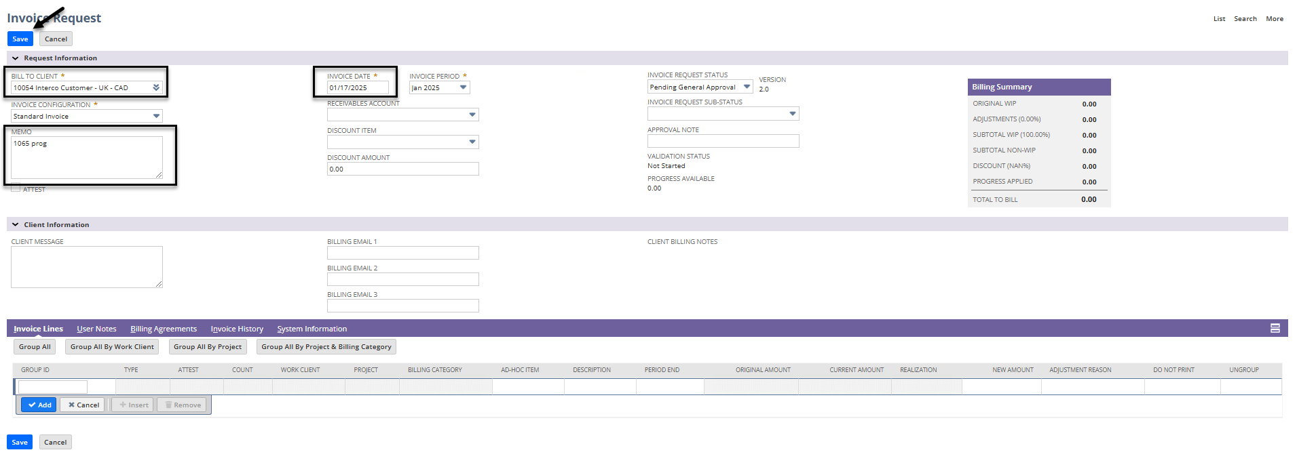
Progress Billing Continued
Enter the client name or ID that you would like to create the progress invoice for, ensure the date is what you would like, and enter your memo.
Select Save.

Slide 25
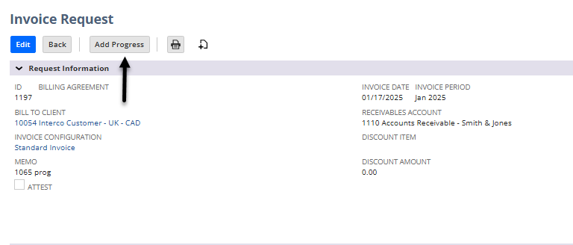
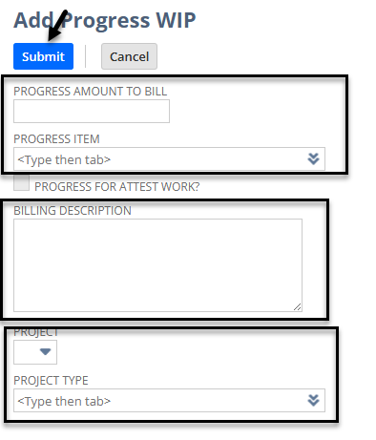
Progress Billing Continued
On the next screen select Add Progress
Once you have selected add progress you will be taken to the screen shown on the right.
  Enter in the amount you wish to charge.
  Select your progress billing service item.
  Provide a billing description per firm requirements.
  You can select a project and type if you wish. This will help understand what each line of progress is for when you wish to apply it to the WIP.
  Select Submit

Slide 26
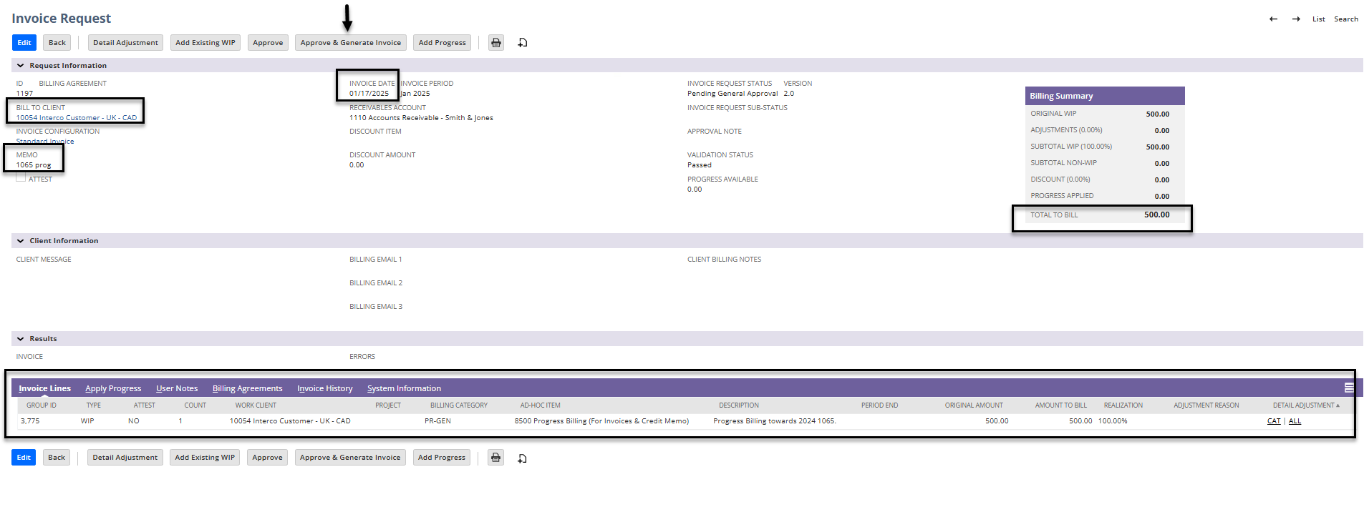
Progress Billing Continued
Verify that the invoice request is correct and then select approve and generate.

Slide 27
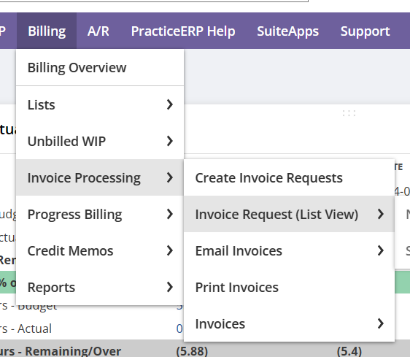
Emailing Invoices
When all invoices have been created for the day or cycle (firm preference) you would want to verify that all of your ques are clear.
To do this go to Billing > Invoice Processing > Invoice Request (List View)

Slide 28
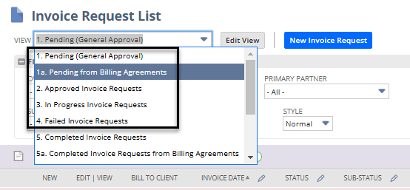
Emailing Invoices Continued
Your next screen will look like the one below. If you select the View dropdown you will see many options.
You want to verify that there are not invoices waiting for approval in queue 1.
That there are not any Billing Agreements needing approval in queue 1a.
That there are not any invoices in queue 2 waiting to be generated.
That there are not any unfinished invoices in queue 3.
That there are not any invoices in queue 4 that failed.
Once all of these ques are clear you can move forward with emailing and then printing

Slide 29
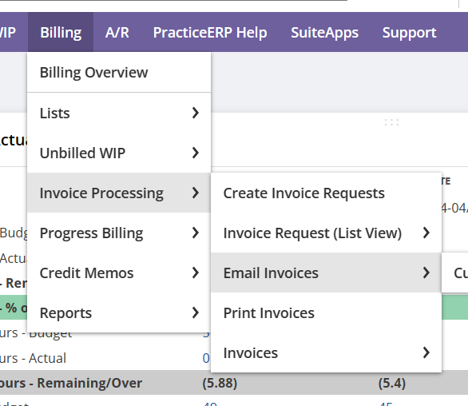
Emailing Invoices Continued
Go to Billing > Invoice Processing > Email Invoices
Emailing invoices prior to printing will remove these invoices from your print queue. This is best practice to avoid sending duplicate invoices.

Slide 30
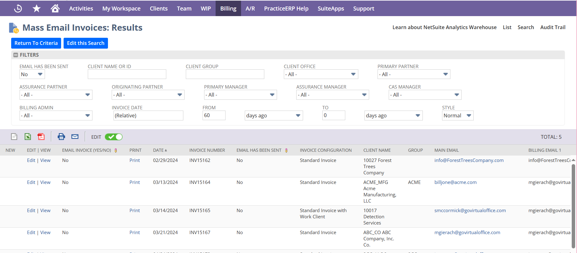
Emailing Invoices Continued
On the Mass Email Invoice screen, fill in the filters that you need to see the invoices you want to email. This may be by a certain Partner, Manager, Billing Admin, date range, etc.
You can sort the list by the columns as needed.
Once all filters are selected your list is ready to send.

Slide 31
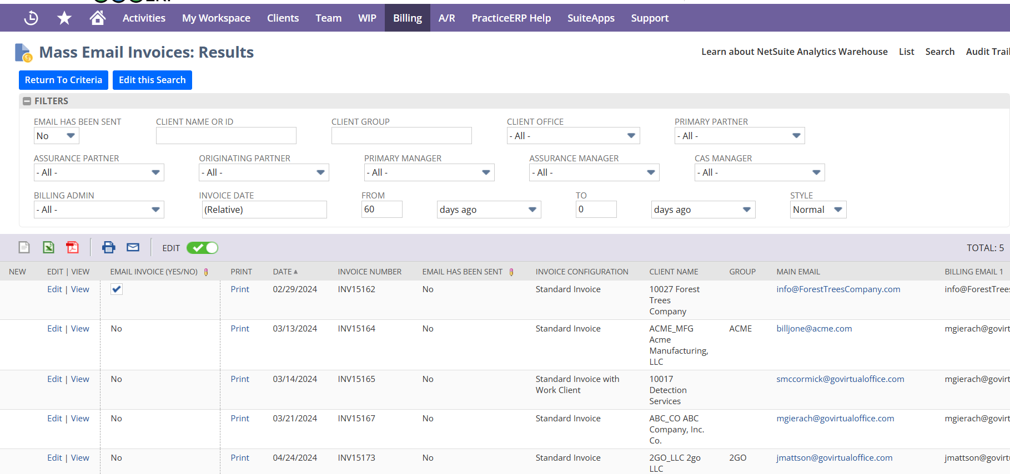
Emailing Invoices Continued
You can send invoices one by one by selecting the word No in the Email Invoice (Yes/No) column and then hit tab.
To sent multiples at once you would select the word No in the Email Invoice (Yes/No) column on the top invoice, scroll to the bottom on the list, hold down shift and select the word No on the last invoice in the same column. It will place a dotted box around the invoices you want to send. Then hit tab and they are in the process of being sent.
Tip: Have your - email has been sent filter to no so that you are only looking at invoices that haven’t been sent to clients yet.
If you want to remove the invoice from the list without sending check the no in this column to change it to a yes and it will act as if the invoice was sent and remove it from the list.

Slide 32
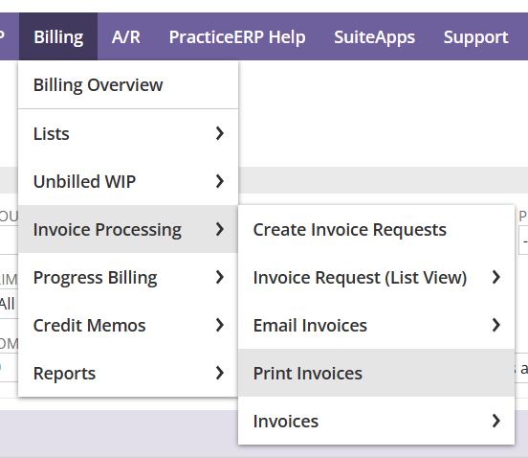
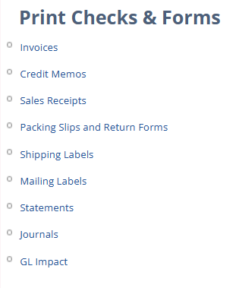
Printing Invoices
After you have emailed your invoices the remaining ones that did not have a billing email assigned will be in the print queue.
  Go to Billing > Invoice Processing > Print Invoices
On the next screen select Invoices as shown on the right

Slide 33
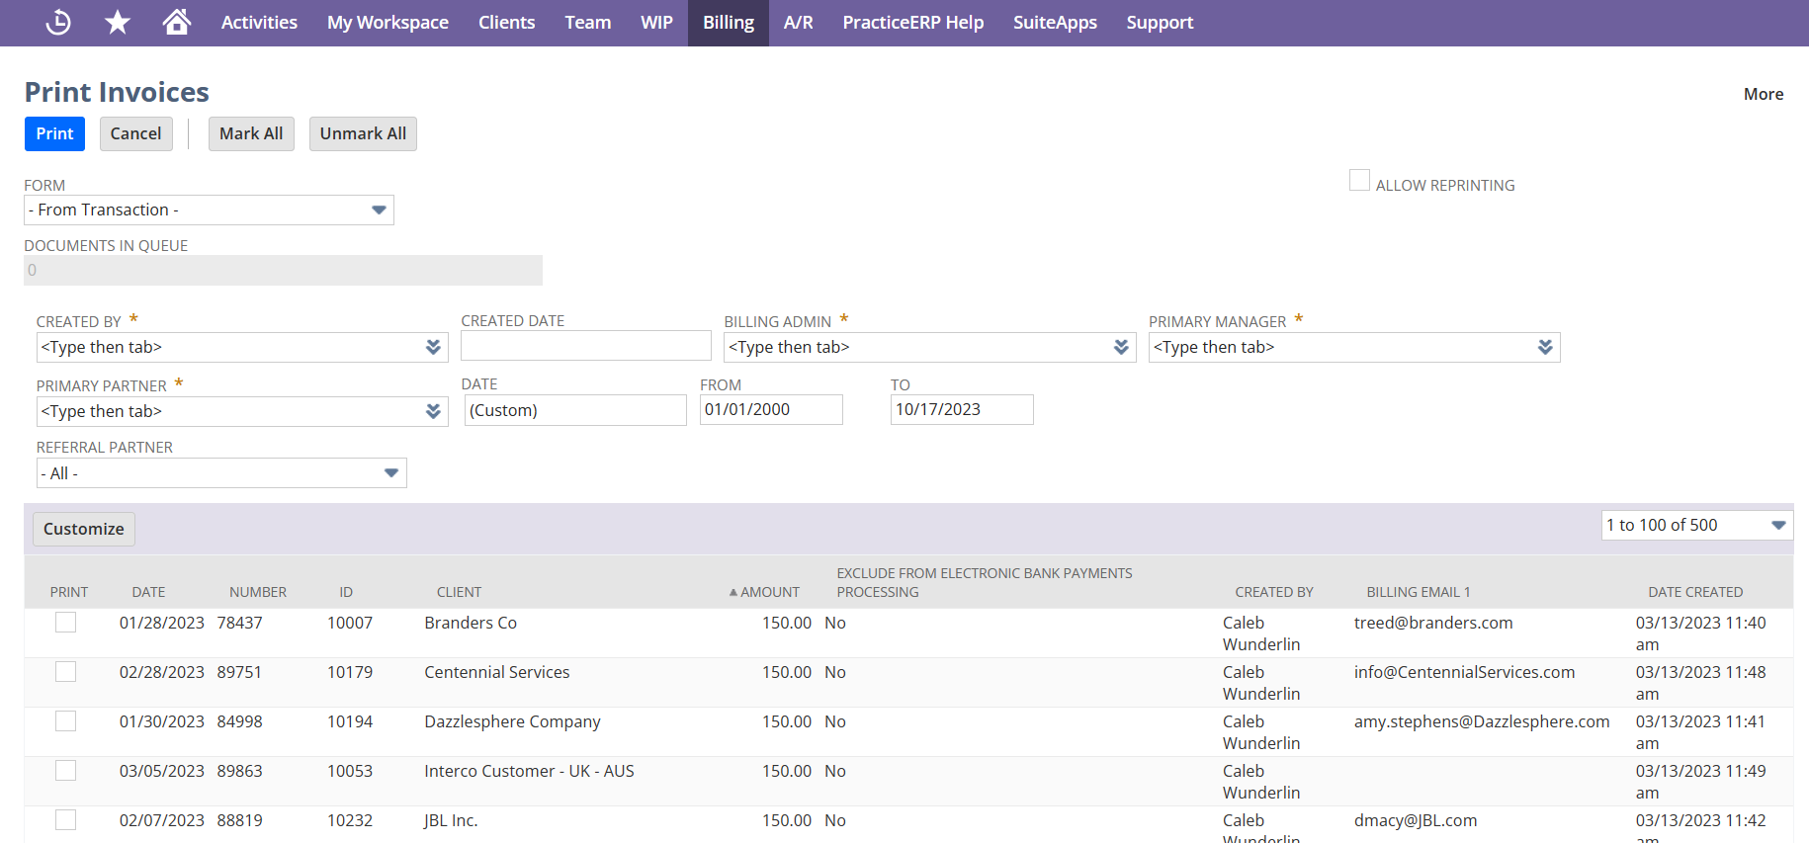
Printing Invoices Continued
On the Print Invoices screen you can enter the filters needed. If you do not see the filters you would like, you can select customize and add filters.
You can also add more columns through the customize button to see specific needed information. You can also sort by clicking on the column to get your desired order. (Sorting by dollar amount may be ideal to avoid sending out the $0.00 invoices)

Slide 34

Printing Invoices Continued
Once you have your filters and columns added they will remain on your print invoice screen in the future as this is a sticky function.
Select Mark All at the top and each of the invoices will be marked for printing. You can then uncheck any of the $0.00 ones that you see or any others you do not want to print.
Select Print. This will move the invoices into PDF format on another tab that you can print and mail.
After they have all been printed go back and select all of the $0 invoices select print but then close out of the PDF portfolio so that they do not get sent to the printer and your queue is clear.

Slide 35
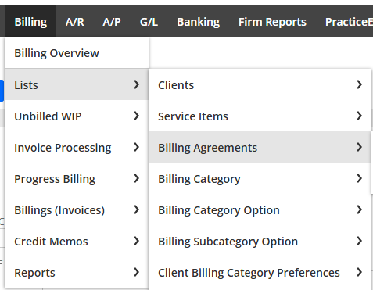
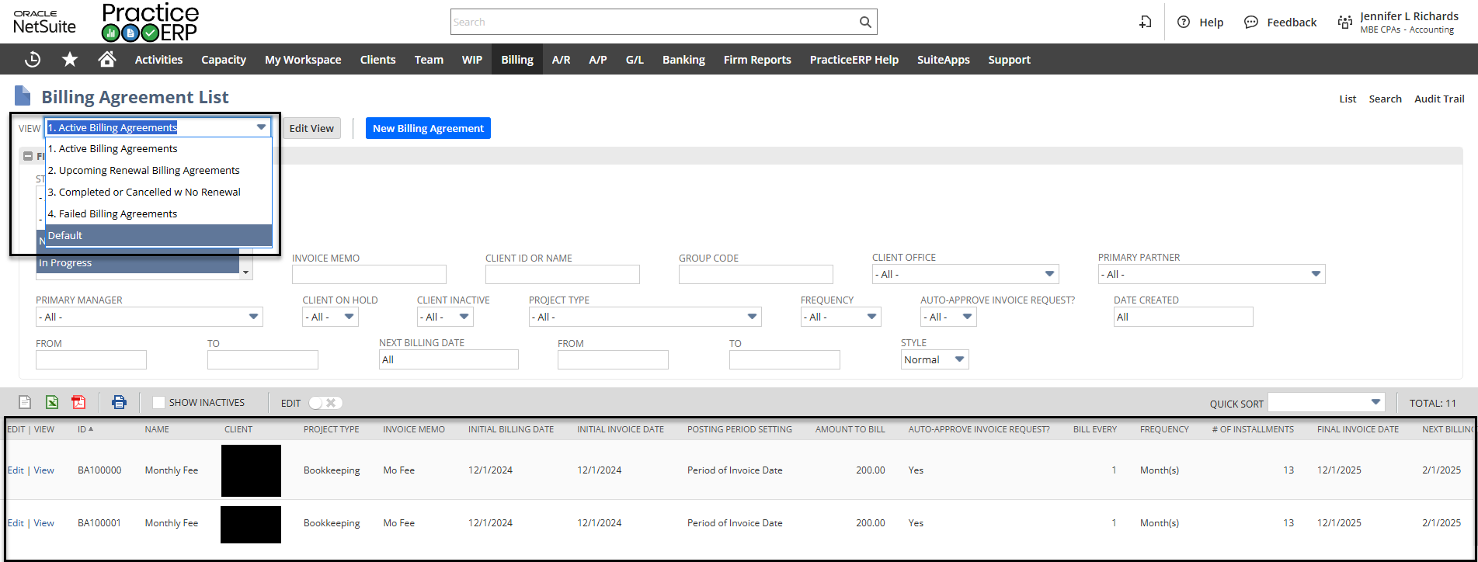
Billing Agreements
Billing Agreements are recurring Progress Billing for your clients. Billing Agreements can be found and created with the following path shown to the right.
This list shows 4 views.
  Active Billing Agreements
  Upcoming Renewal Billing Agreements
  Completed or Cancelled w No Renewal
  Failed Billing Agreements

Slide 36
Billing Agreements Continued
The Billing agreement list is a quick and effective way to find all clients who have or have had billing agreements.
There is also a New Billing Agreement button found at the top where you can enter in new agreements.

Slide 37
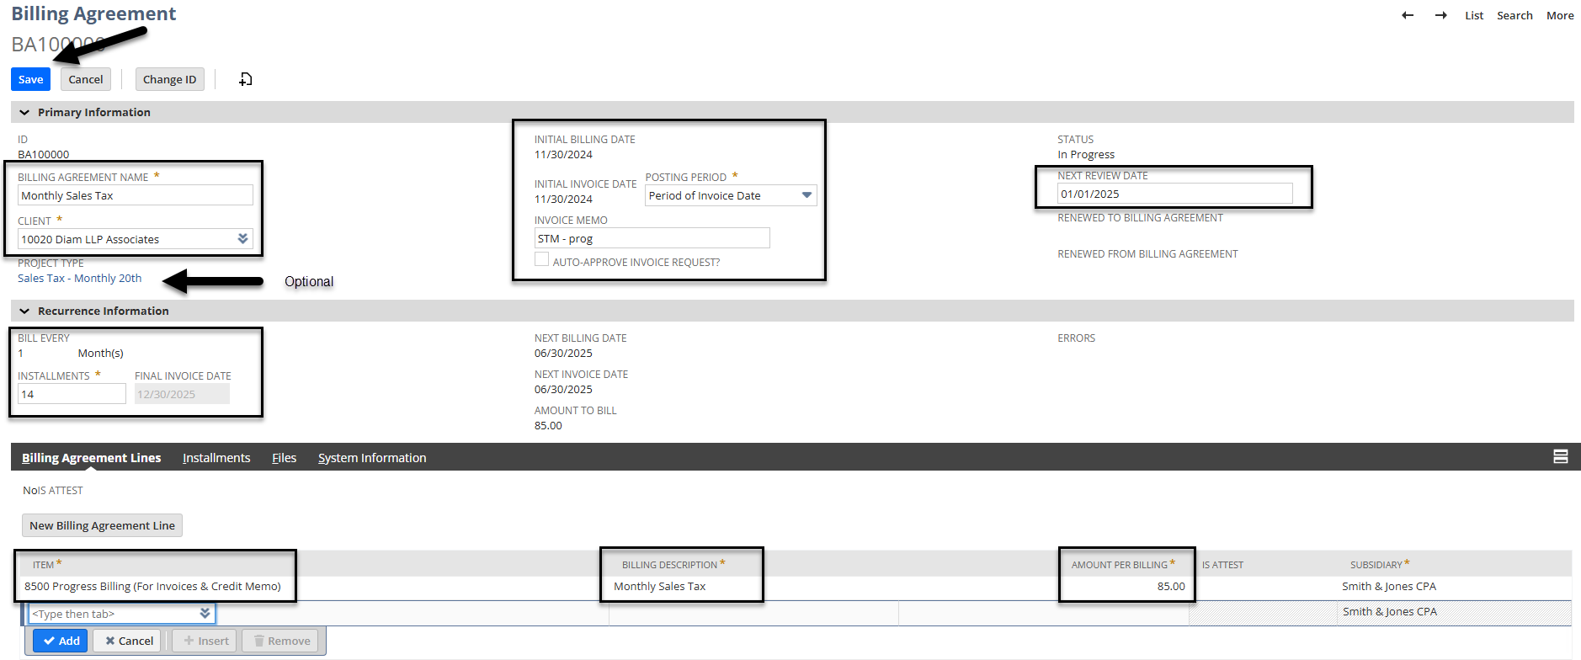
Billing Agreements Continued
When creating a new billing agreement you must fill out all fields as shown below.
In this example the name of the agreement is Monthly Bookkeeping (Clients can have multiple billing agreements or multiple lines on one billing agreement)
Enter in the client, the initial billing date and the initial invoice date
Enter in a memo to appear on the client dashboard, choose if this can be auto approved and the next review date.
  Select the Auto-Approve invoice request if you want the system to automatically generate and approve the invoice. If you do not select this box then the invoice will go into your pending approval request queue.
Continued on the next slide

Slide 38
Billing Agreements Continued
Recurrence Information
  Enter how many times you want it to bill per week, month, quarter, or year.
  Enter how many installments you would like billed. In this example I said I wanted a review date at the end of the year and then I listed eleven installments to populate until the end of the year as I will create a new one with an updated amount.
  Then create your line(s) for billing with a proper PROGRESS item, a billing description that will appear on the invoice, and the amount for the line.
  Verify everything is correct and select Save.

Slide 39
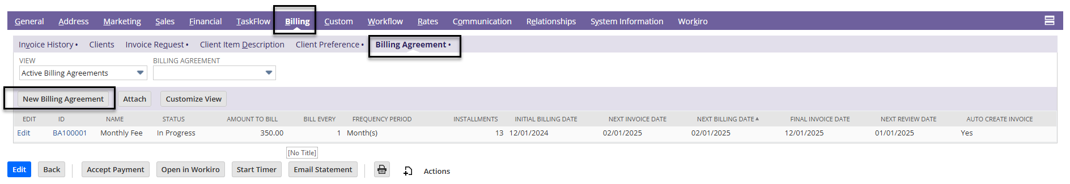
Billing Agreements Continued
Billing agreements can also be entered from a client dashboard. On the client dashboard select switch to form view in the upper right corner.
Then scroll down and select the Billing tab, Billing Agreement Tab, and New Billing Agreement
Steps to fill out the Billing agreement would be the same as listed in the previous slide.

Slide 40
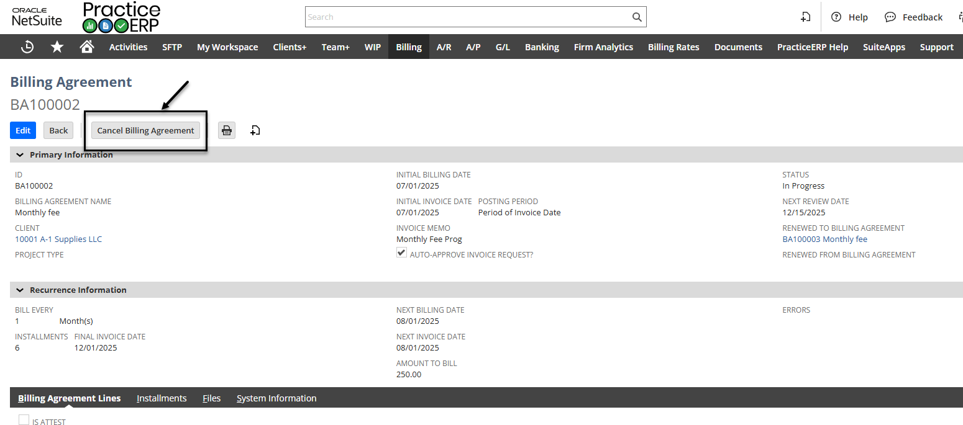
Billing Agreements Continued
If you need to cancel a billing agreement you can do so with the following steps:
  Go to Billing > Lists > Billing Agreements
  Find the billing agreement that you would like to cancel and select View in front of it.
  Once in the view screen you can select the Cancel Billing Agreement button at the top of the screen. The agreement will no longer create an invoice.

Slide 41
Billing Agreements Continued
If you would like to see the invoices that were auto-approved or are in the pending approval queue, please use the following steps:
  Go to Billing > Invoice Processing > Invoice Request (List View)
  At the top there are different views to select
    View 1a – Pending from Billing Agreements
      This lists all invoices that have a billing agreement but did not have the auto-approve box checked within the agreement
        Someone will need to review these invoices and select approve and generate in order for them to go out.
    View 5a – Completed Invoice Requests from Billing Agreements
      This lists all of the invoices that were automatically approved and generated by the system.

